Slide 1

Introducción al procesamiento de Imagen en Microscopia Electrónica
I2PC
Escuela Politecnica Superior
Instruct Image Processing Center, CNB-CSIC
Roberto Marabini Ruiz
Notes:
1
Hello, I am Roberto Marabini
1

Slide 2
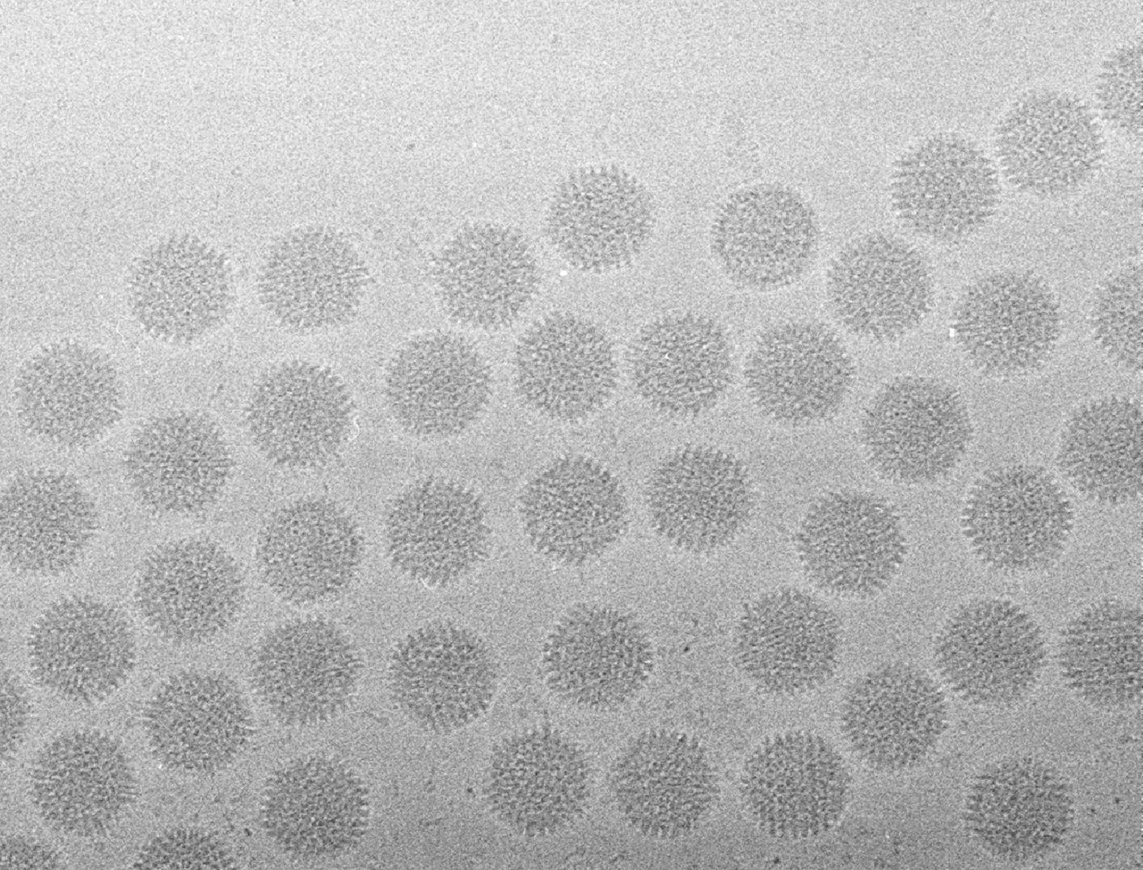
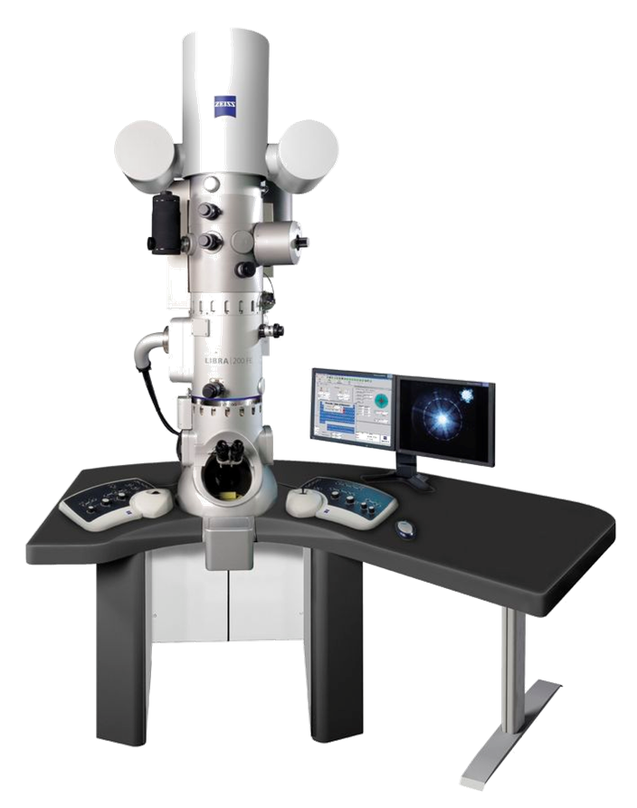
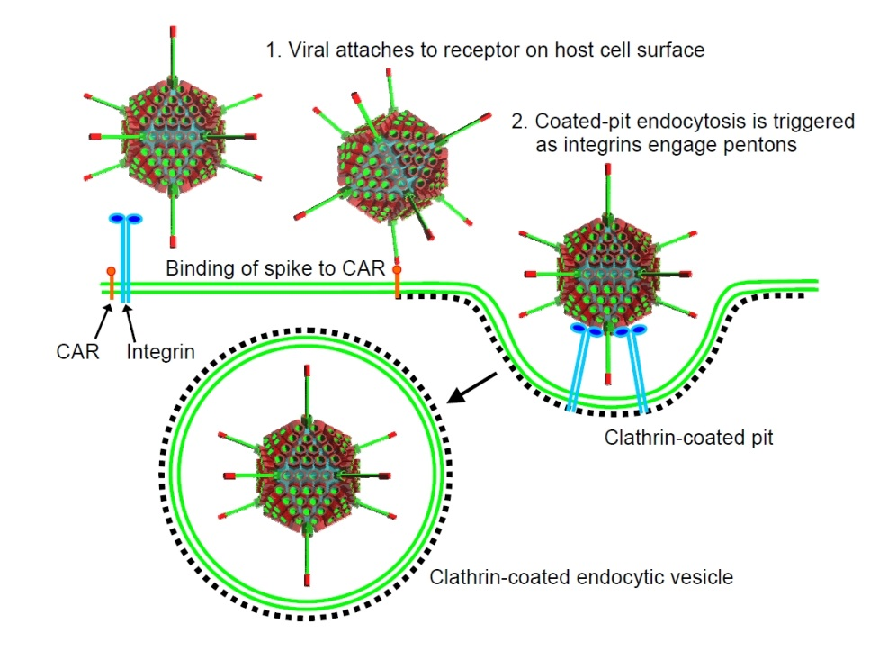
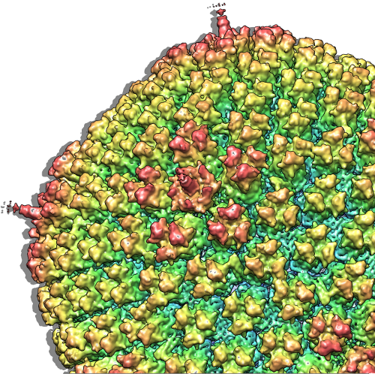
Notes:
Adquire
Data as
Reconstruct
Understand
Amount of data
In this example Data is adquired with an electron microscope like this one
The data look like this dark areas is a virus
Merging the information contained in all the images we can get a 3D reconstruction like this
Reconstruction that may be used to better understand the viral life-cycle
2

Slide 3
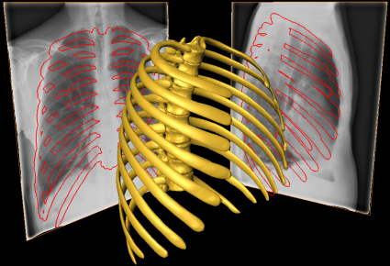
3D Reconstruction
Notes:
X-ray microscopy may be used to obtain structural 3D information from 2D images. Carolyn has just show some very nice examples. In this talk we will center in x-ray image formation model, that is, how the experimental data represented here by these two images is related with the
3D object.
WE are interested in the image formation process because is the first step in performing the inverse problem: reconstructing properly a real object
3

Slide 4
What we do…
… in more detail
Notes:
Present what we do
Focusing on
Overview
And I would like to present you the work we develope at the I2PC in the area of image processing.
Let me show in a single slide the kind of work we do and then I will focus on workflows and data management
4

Slide 5
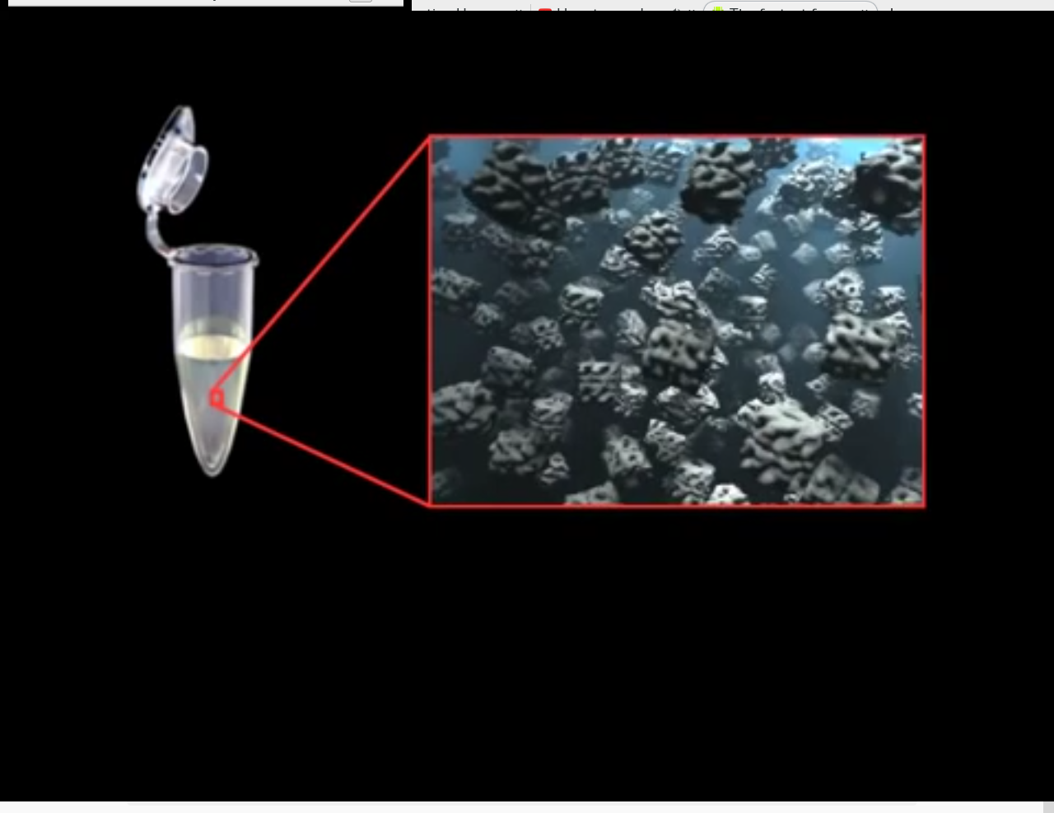

Slide 6
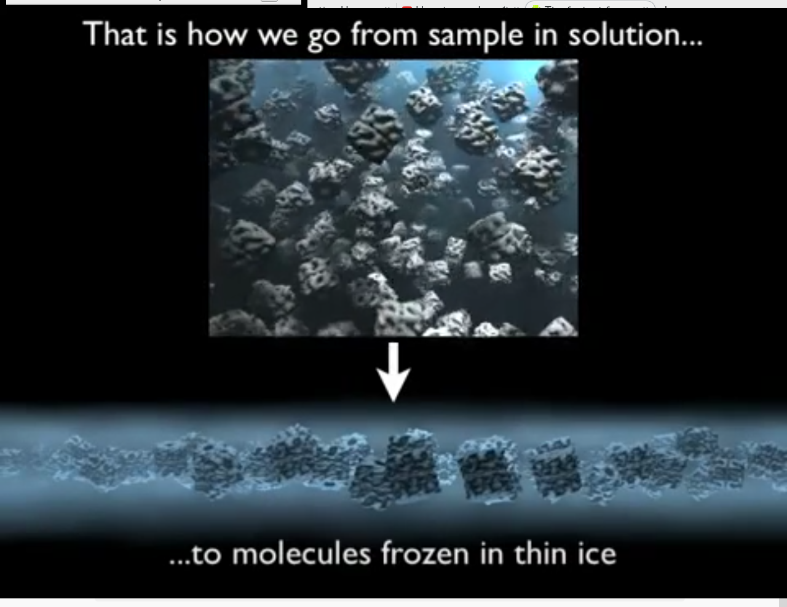

Slide 7
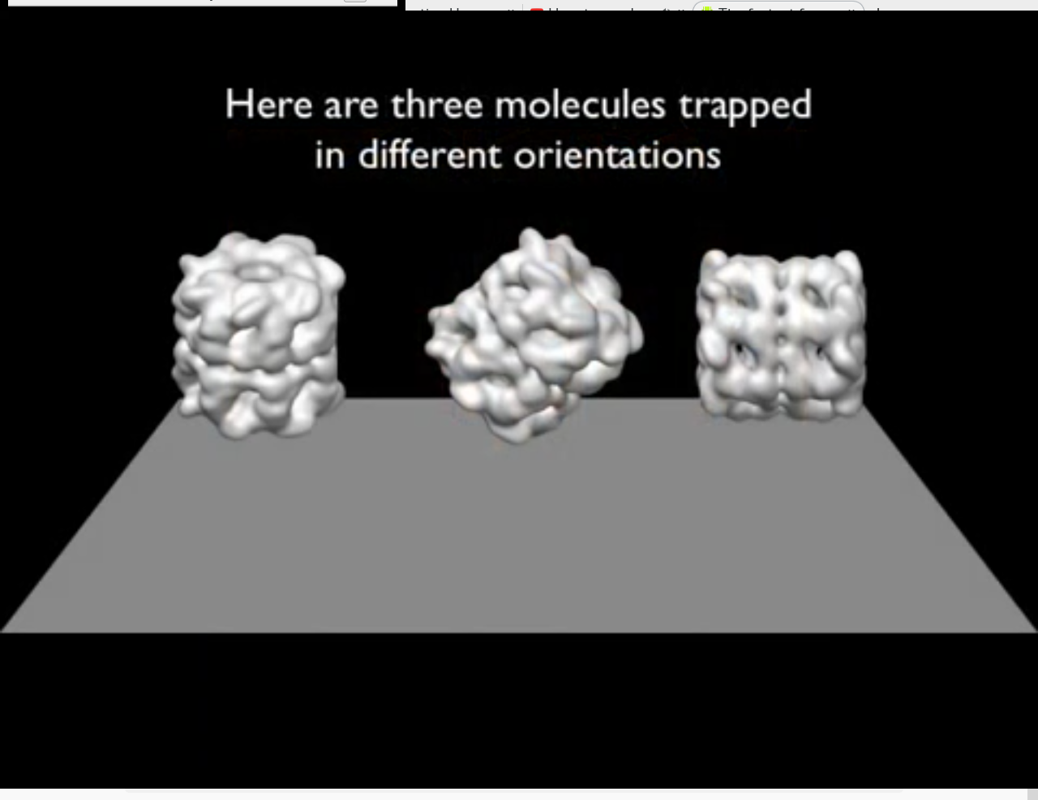

Slide 8
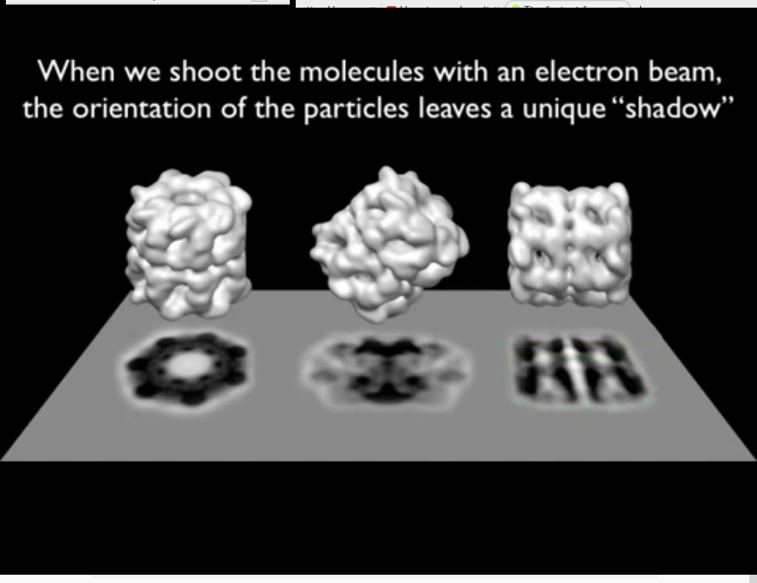

Slide 9
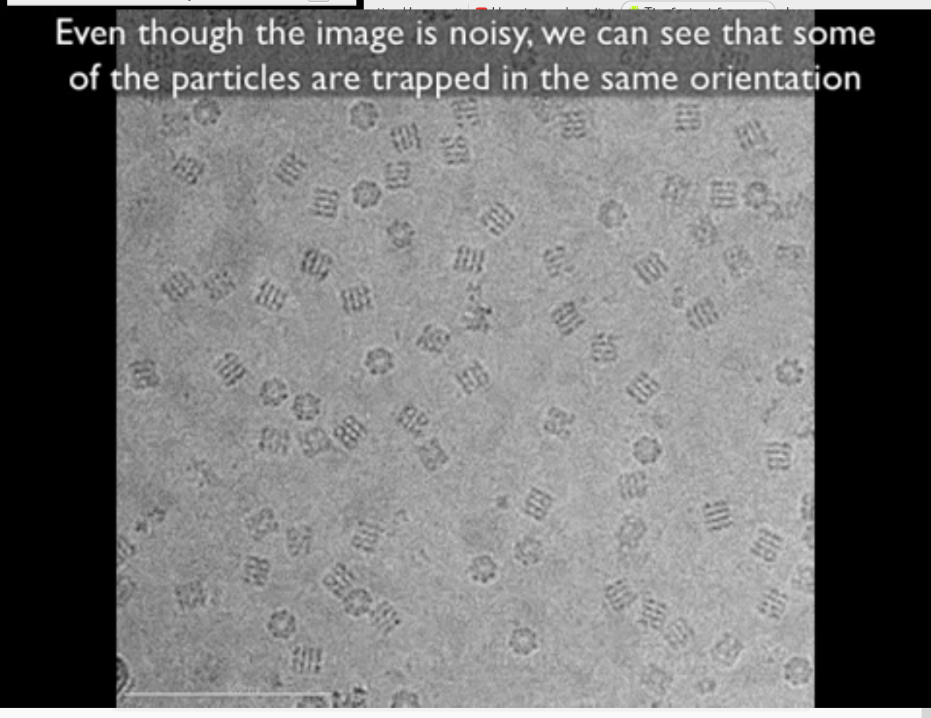

Slide 10
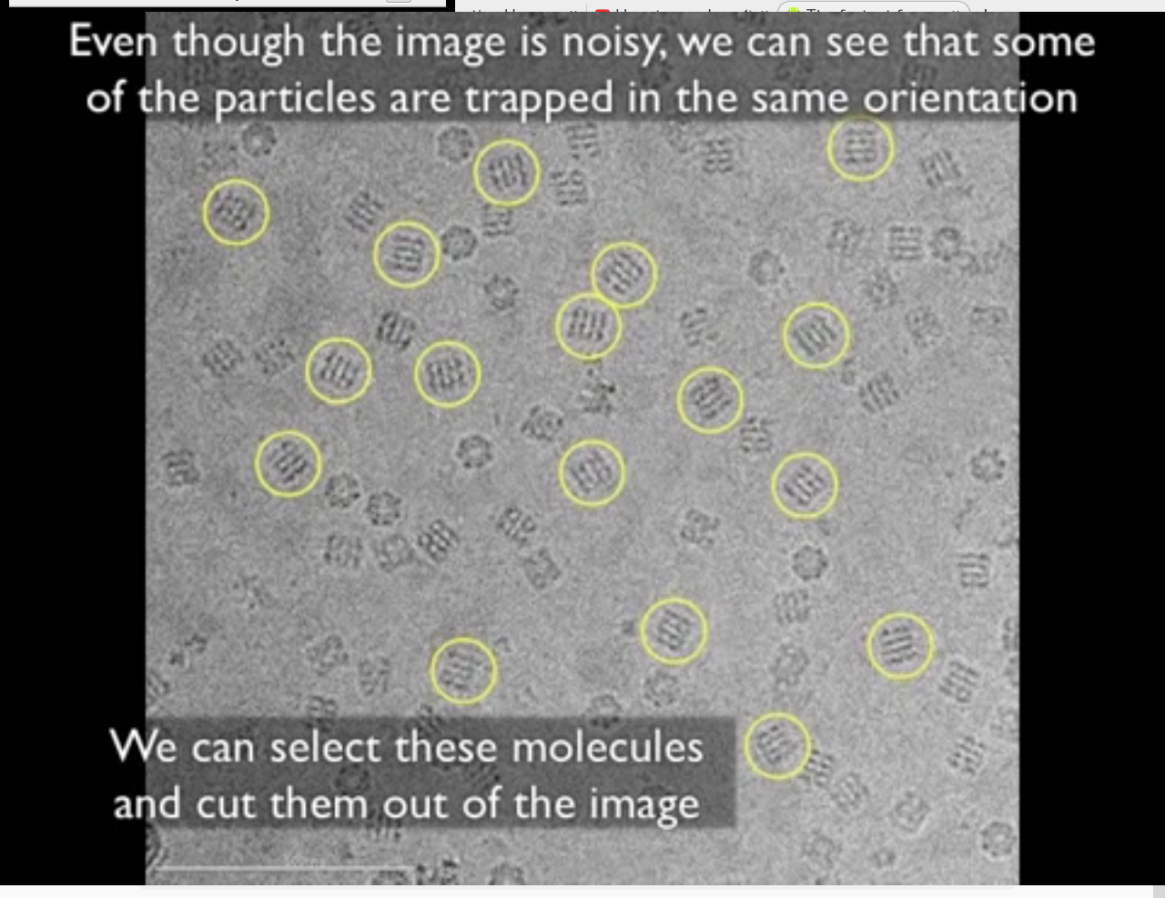

Slide 11
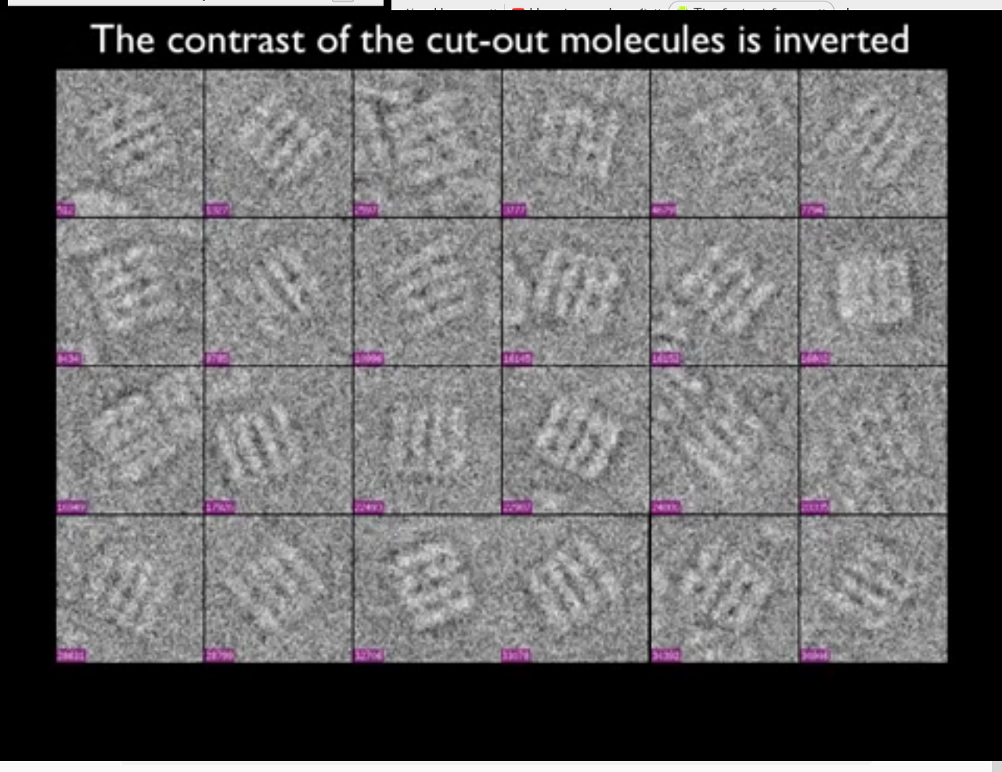

Slide 12
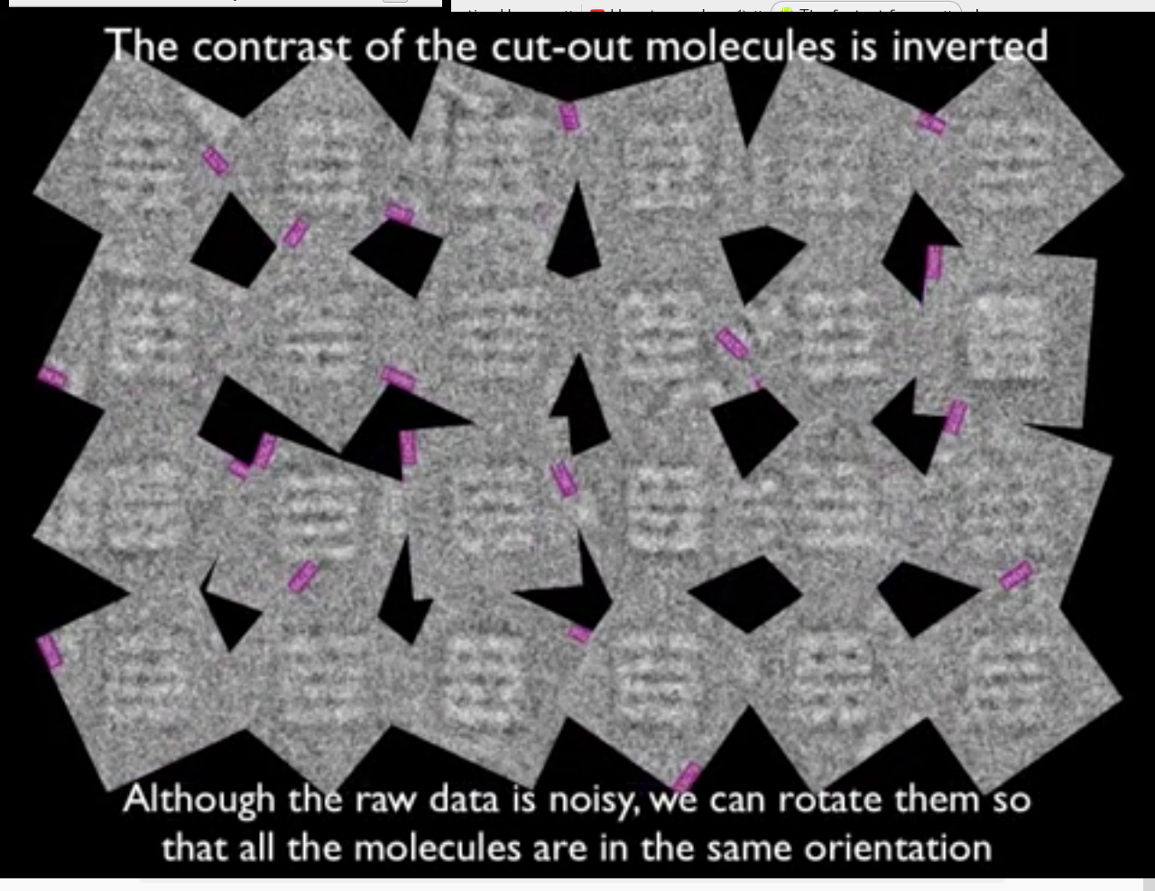

Slide 13
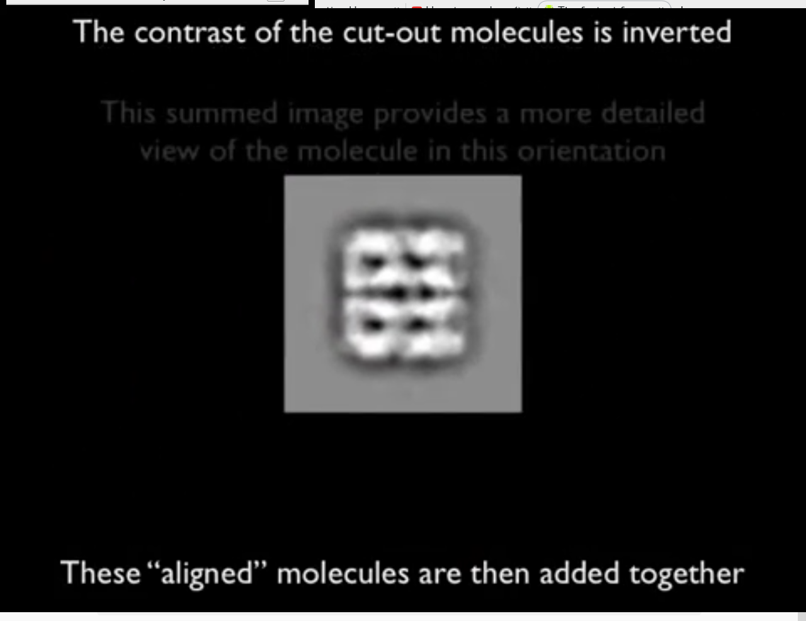

Slide 14
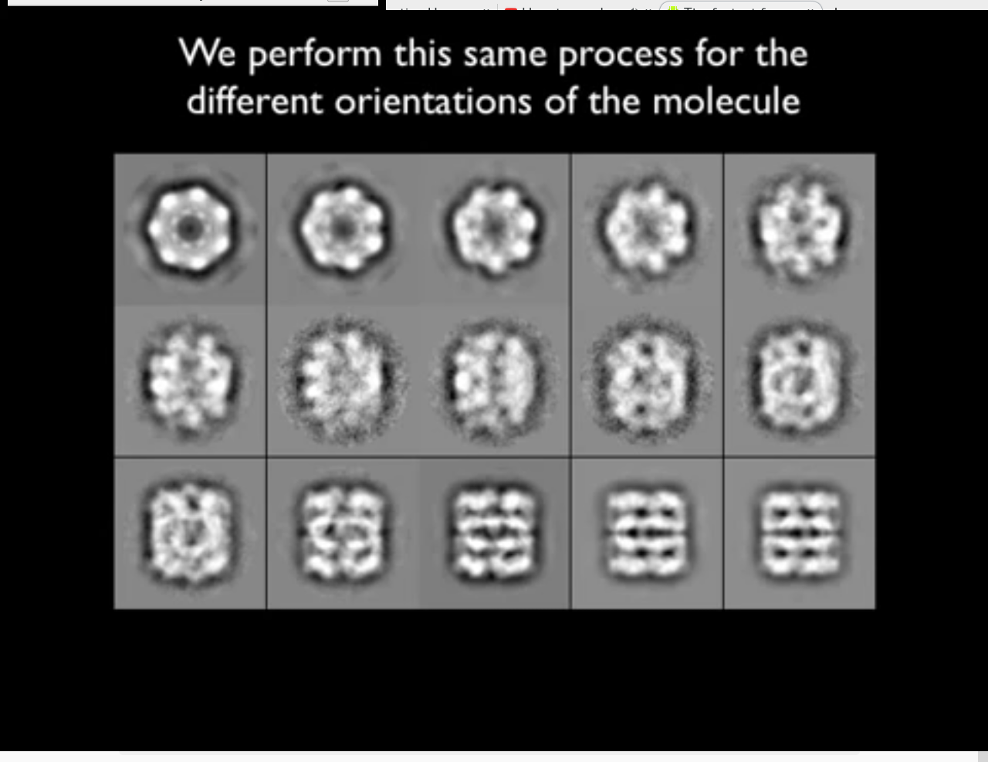

Slide 15
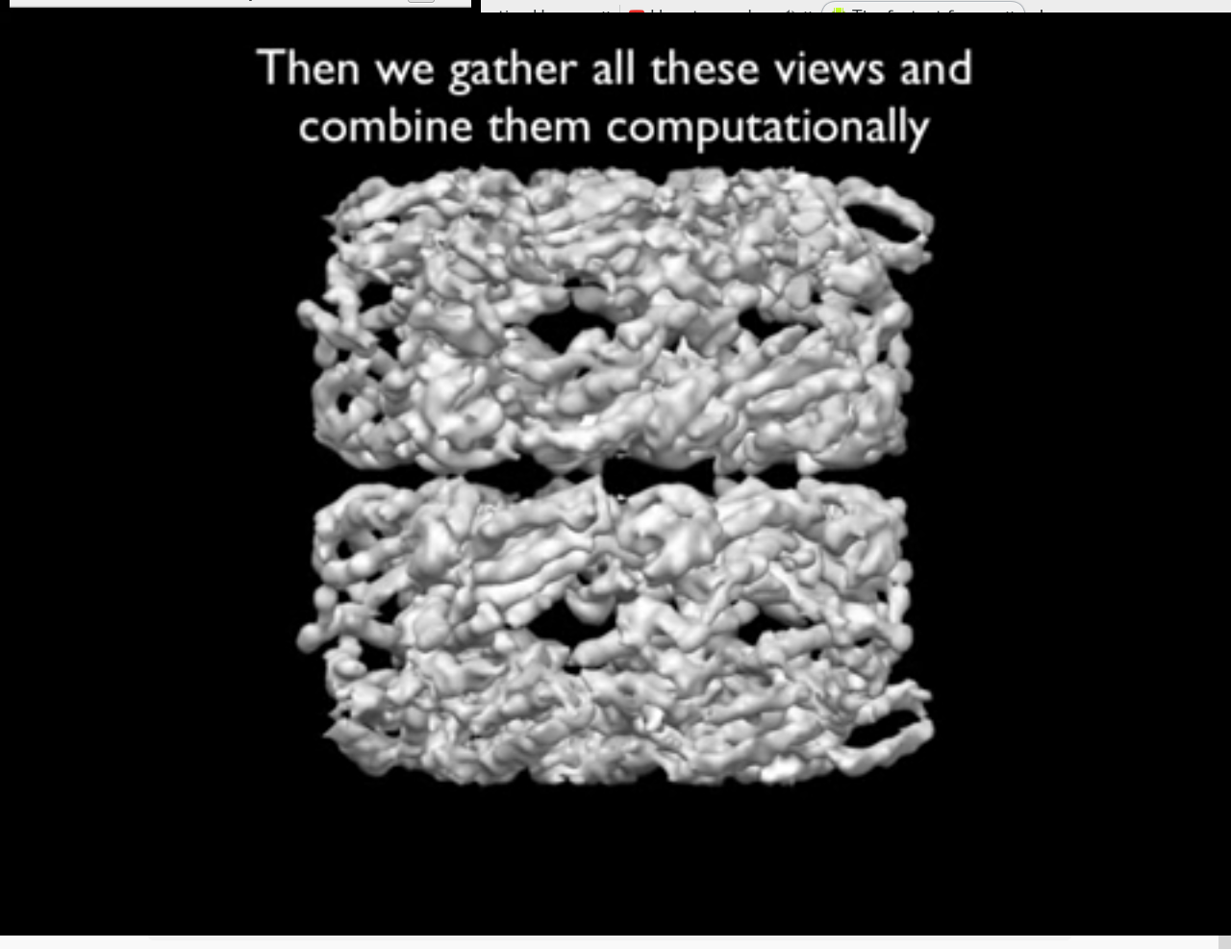

Slide 16
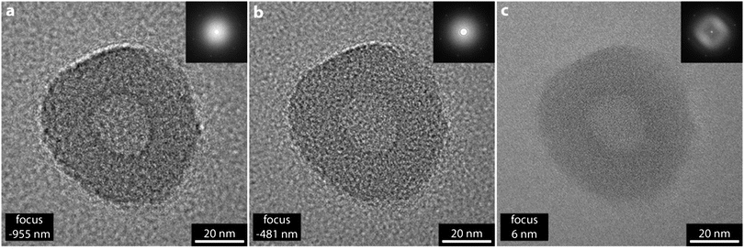

Slide 17
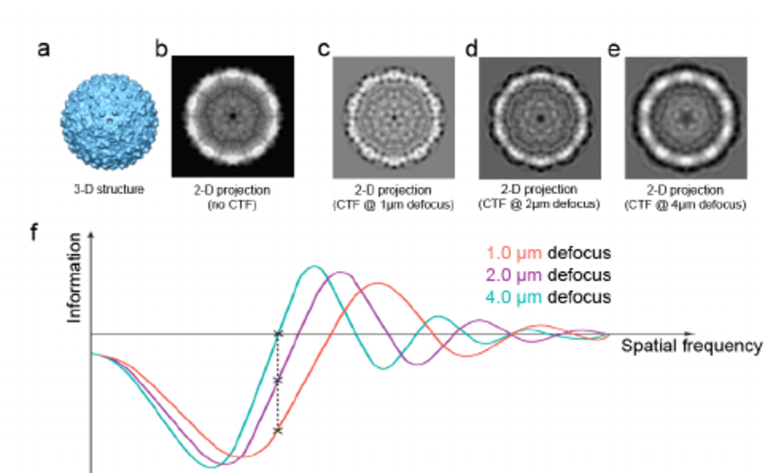

Slide 18
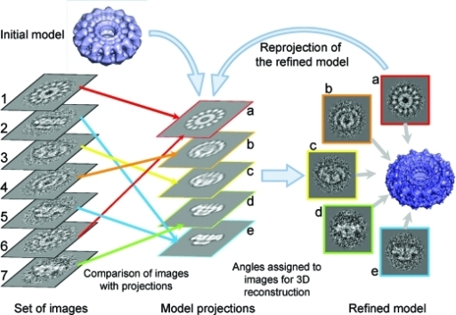

Slide 19


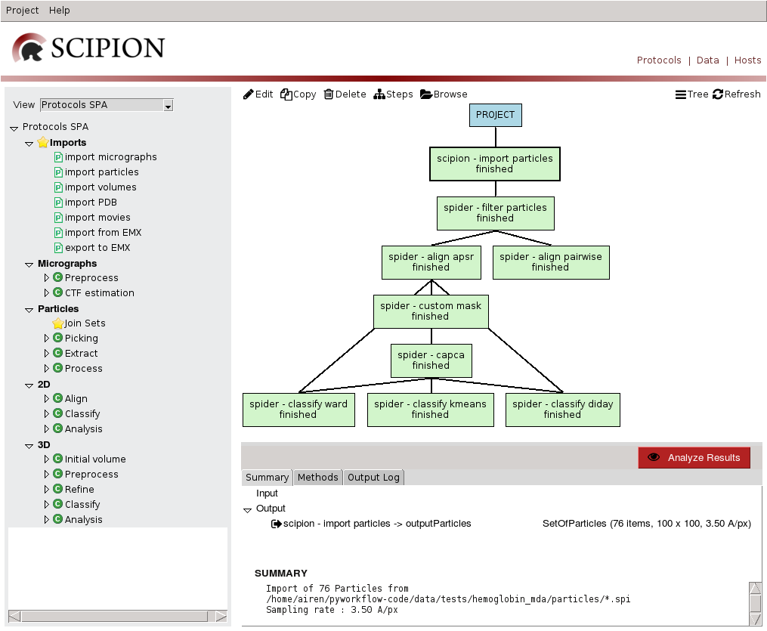
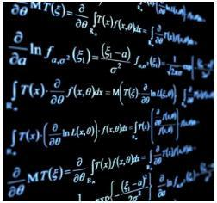
http://scipion.i2pc.es
Notes:
IMAGE PROCESSING -> 2 PACKAGES
Are provided
In the are of image processing we produce two packages
One is called Xmipp and is the place where our algorithms are implemented
The second one is called scipion. Scipion contains the GUI that allows user to acces to xmipp as well as a basic workflow engine
It also handels reproducibility and repetibility
19

